Slide 1
The Complete Front-End Development course
Our own ecommerce website

Slide 2
Module 5
Interacting with the client
Using wireframes or mockups
Building the website
Code walkthrough with me

Slide 3
Interacting with client
What is your business for which the website is required?
What kind of a website is required?
What features are required?- Give examples from similar websites
What is the timeline in which these features are to be submitted?
Who is going to be the Point Of Contact?
How is the data to be provided for the website?
Negotiations!
Limit the number of revisions
Involve others to help you produce a great product eg graphic designer, photographer etc
Notes:
Visit with the Client- Bring eg of toher sitest o help client figure out what they want
Encourage client to use less information
Client should invest in the project
Client should have one person as the deicder
Limit number of revisions
Involve others to help you produce a great product eg graphic designer,photographer etc
To create mockups – balsamiq.com gives text based mockup files.
Use google.com/fonts to know what best fonts to use and options available with them. Make sure the chosen things keep the page loading fast for UX.

Slide 4
Wireframes
Consider our website- Swag of India
Use the SRS you created for the module 1- What are the features and layout required for our ecommerce website?
Mockups- Canva.com
Creating the SRS of our ecommerce website
Notes:
https://www.fabindia.com/
https://www.mirraw.com/
https://dribbble.com/search/ecommerce
Consider the sample Software Requirements Specifications documents provided. Create your own SRS document for your ecommerce website using these samples. Complete the missing pieces of the document with the additional details explained in this module. Consider the wireframes of the website provided and include all the specifications observed in them in your SRS.

Slide 5
Start building your website
Creating the html structure
Styling your homepage
Have we followed all the UI principles?
Notes:
Create the html structure of the homepage as shown in the example using the provided images. Put descriptive comments on every tag. You can use other images from unsplash.com and flaticon.com
Style your ecommerce home page created in the earlier assignment based upon the mockup provided
Add descriptive comments for everything you implement
Layout using bootstrap
Make your website responsive for small, medium and large devices. Add a hamburger for small devices in navigation menu. Stack- categories, latest products one upon another.
Create bootstrap dropdown on the navigation bar.
Add a carousel for the main photo slider.
Use bootstrap card for bottom 4 divs.
Use Websafe fonts in your webpage.
Add fontawesome fonts in your webpage as explained.
Add ARIA code in your webpages created thus far.
Create a report on how your webpage conforms to all the principles we have discussed in our module. If it doesn’t then make changes in your site so that it does and include that change in your report.

Slide 6
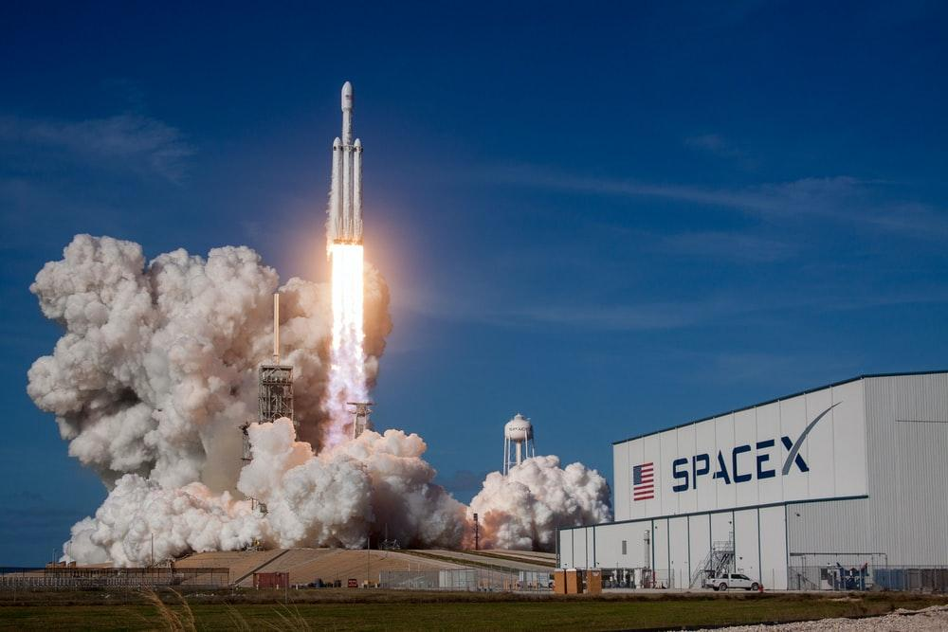
Code walkthrough with me

Slide 7
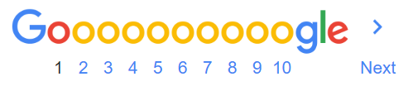


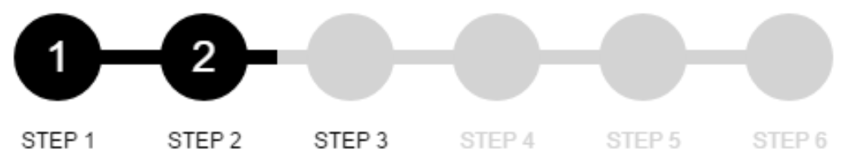
Pagination

Slide 8
Summary
Interacting with clients
Wireframes/Mockups
Coding hands on

Slide 9
Motivational Tip
As a Software Engineer/Front-End Developer- NEVER FEAR THE UNKNOWN.
Don’t be overwhelmed with challenges- things you have no idea about.
You can’t avoid constant learning- frameworks, tools etc.
Debugging difficult bugs.
Reading documentations, Googling, Stackoverflowing- It IS a struggle for everyone
BE ready to spend hours in front of the computer ALONE. Get a habit not to get up every 10 min for a break. The focus can never be achieved with it.

Slide 10
Assignment
Create a bootstrap modal for user login and registration for your ecommerce website at the click of the sign in button. Test it to have html5 validations.
Create a thank you page as shown in the mockup

Slide 12
Minor Project
Create the seller page as shown in the mockup
Create the return order page as shown in the mockup
Create the “my profile” page with the side navigation bar as shown in the mockup with an edit button.

